Slide 1

Dr. NTR UNIVERSITY OF HEALTH SCIENCES VIJAYAWADA, ANDHRA PRADESH MDS PRACTICAL EXAMINATION –SEPTEMBER 2020
GOVERNMENT DENTAL COLLEGE AND HOSPITAL
DEPARTMENT OF PERIODONTICS AND IMPLANTOLOGY
HT .NO: 18D315011003

Slide 2
MINOR CASE PRESENTATION

Slide 3
Demographic data
Name: Sreeja
Age: 23 yrs
Sex: Female
OPD no: Feb 4.19
Occupation: Student
Address: Kadapa

Slide 4
Chief complaint: Patient complaints of swelling and bleeding of gums in upper front tooth region from 4 months.
History of present illness : History of bleeding gums from past 6 months while brushing and noticed swelling of gums from 4 months.

Slide 5
Past dental history: Patient has undergone orthodontic treatment. Removal of braces 4 months back.
Medical history : No Relevant Medical History
Family history: No Relevant Family History

Slide 6
Oral hygiene habits:
Type: Soft
Direction: Modified bass technique
Duration: 3-5 minutes
Dentifrice: Non medicated
Frequency: Once daily in the morning

Slide 7
General examination: Conscious, coherent, cooperative and well oriented.
Extraoral examination:
Symmetry: Apparently symmetrical
Lymph nodes: Not palpable
TMJ: No Abnormality Detected
Lip seal: Potentially competent

Slide 8
INTRAORAL EXAMINATION
Labial mucosa: No Abnormality Detected
Buccal mucosa: No Abnormality Detected
Tongue: No Abnormality Detected
Palate: No Abnormality Detected
Floor of the mouth: No Abnormality Detected

Slide 9
Halitosis: Present
Local causes: Plaque and calculus
ORAL HYGIENE STATUS:
OHI-S=D.I-S+C.I-S
1+1=2 FAIR ORAL HYGIENE
16 | 11 | 26
1 | 1 | 1
1 | 1 | 1
46 | 31 | 36
16 | 11 | 26
1 | 1 | 1
1 | 1 | 1
46 | 31 | 36

Slide 10
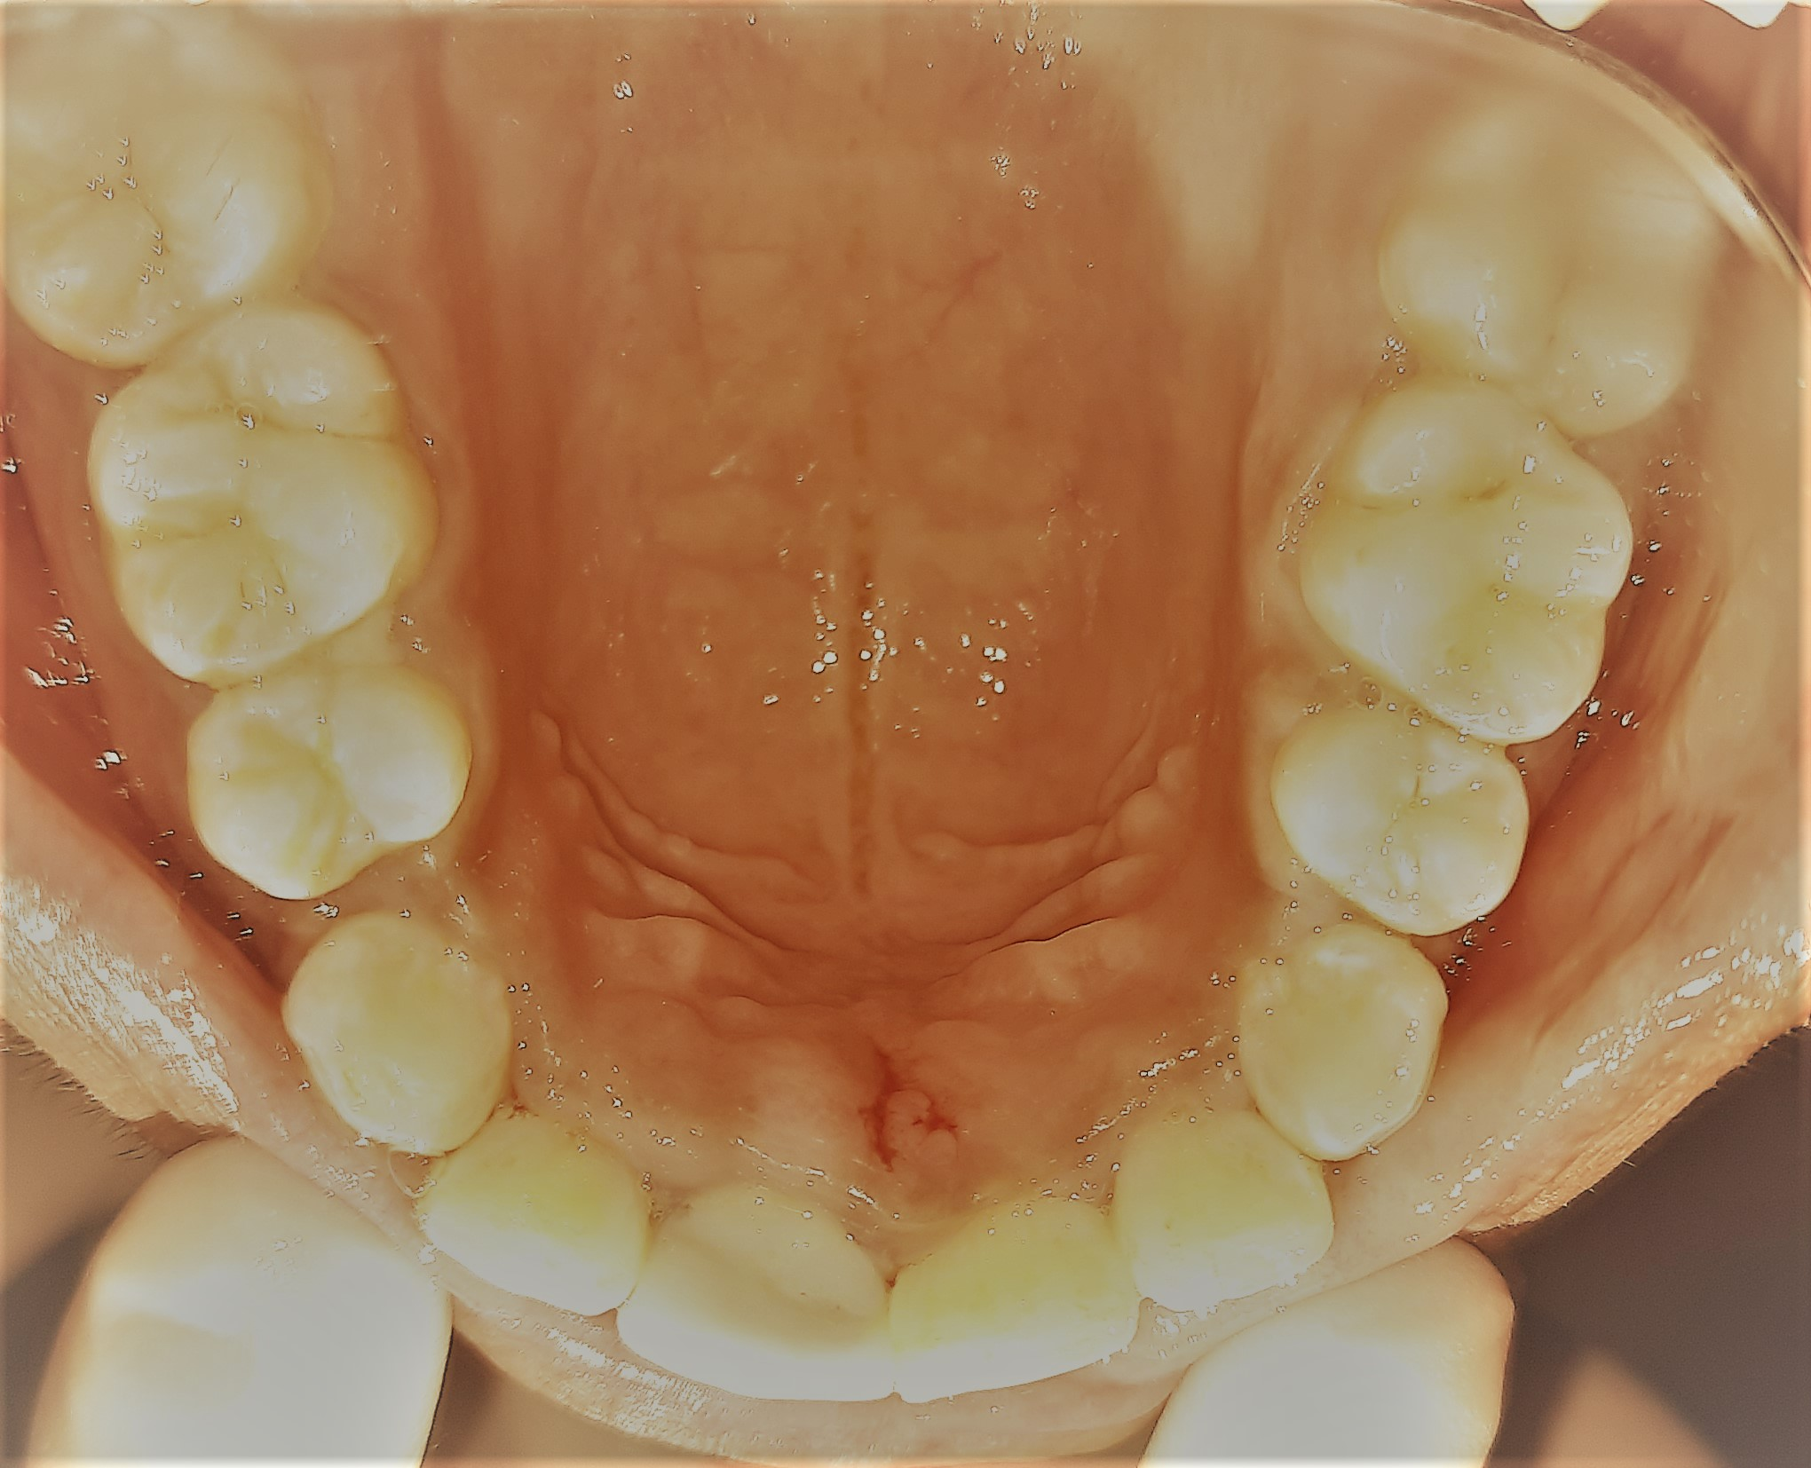
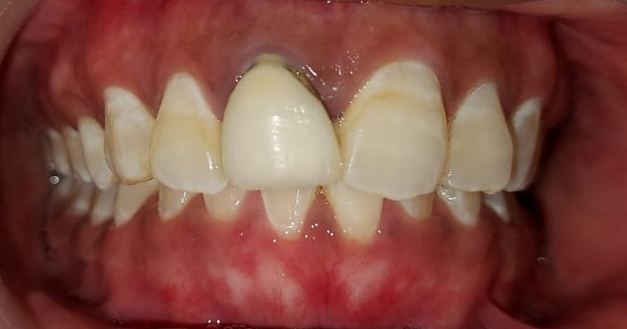
GINGIVAL STATUS
Color: Erythematous and reddish gingiva on palatal surface of maxillary anteriors 11,12,13,21,22,23

Slide 11
Consistency: Soft and edematous
Contour: Altered contour with rounded edges.
Size: Moderate enlargement is seen on palatal surfaces of 11,12,13,21,22,23.

Slide 12
Surface texture: No loss of stippling
Position: Coronal displacement of papillary and marginal gingiva irt 11,12,13,21,22,23
Bleeding on probing: Generalized

Slide 13
Dental status:
Number of teeth: 28

Slide 14
Occlusal analysis:
Type: Angles class 1 malocclusion
Overbite: 2 mm
Overjet: 3 mm

Slide 15
Final diagnosis: Dental biofilm induced gingivitis
Prognosis:
Overall: Good

Slide 16
TREATMENT PLAN
Phase I: Patient education and motivation
Oral hygiene instructions
Scaling and root planing
Phase IV: Recall and maintenance for 3 months

Slide 17
Phase II:
Advised Gingivectomy irt 11,12,13,21,22,23.
Phase III: Advised Crown replacement irt 11
Phase IV: Recall and maintenance for every 3 months

Slide 18
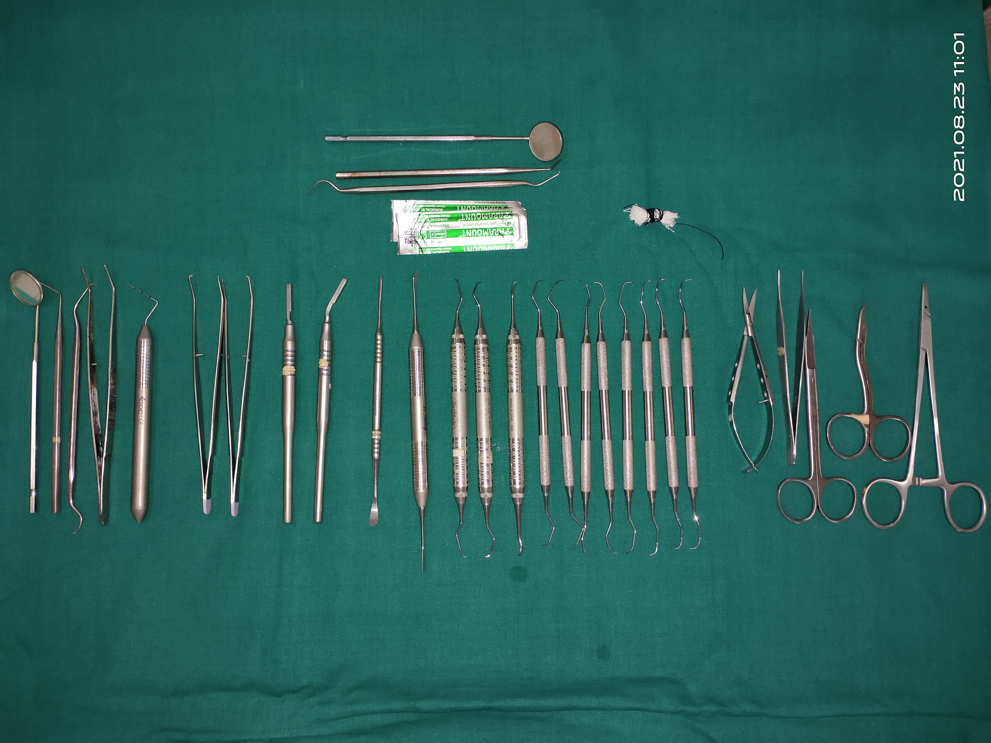
ARMAMENTARIUM

Slide 19
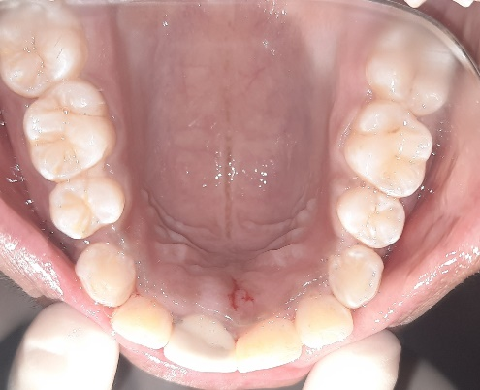
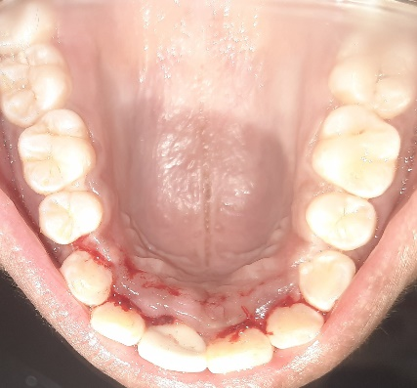
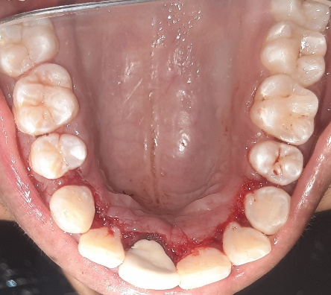
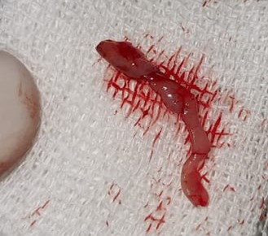

Slide 20
